Slide 1



CAAFI 2014
General Meeting
& Expo
Public-Private Partnership Efforts
Moderated by: Nate Brown,
FAA Environment & Energy
Produced by

Slide 2
CAAFI 2014
General Meeting
& Expo
Bill Goldner,
USDA
Produced by

Slide 3
National Institute of Food and Agriculture – USDA
Catalyzing Partnerships in Renewable Aviation Fuel
Production Systems
CAAFI Biennial General Meeting January 29, 2014
Bill Goldner, Ph.D.
wgoldner@nifa.usda.gov

Slide 4
National Institute of
Food and Agriculture Sustainable Bioenergy
Facilitate system-based approaches for development of sustainable supply chains for the production of biofuels, biopower, and bioproducts.
>$140 M NIFA current five year investment in renewable aviation fuel supply chains.
  Agriculture and Food Research Initiative: $112 M
  (four projects)
  Biomass Research and Development Initiative: $20 M
  (three projects)
  Non-competitive: ~$6 M

Slide 5
Regional Approaches to Bioenergy Systems
  Coordinated Agricultural Projects (CAP)
    Regional partnerships
      Academic, industry, government, non-government,
    Work back from targets to develop entire supply chains
    Build on existing infrastructure and previous investments
    Integrate Research, Education, and Extension/Tech Transfer
    Robust sustainability analysis: Impacts on …
      Economics, rural communities, and the environment
    Targeted Feedstocks (perennial grasses, energy cane, sorghum, woody biomass, oil crops)
    2010-2013: 7 AFRI awards totaling ~$156 M over 5 years

Slide 6
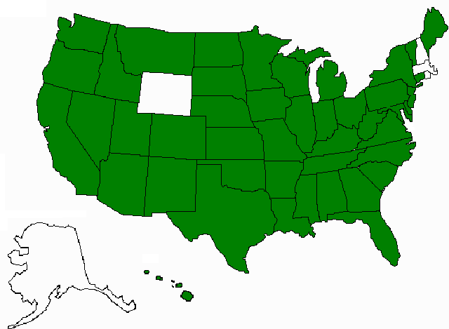
Softwood Residues *
Switchgrass MiscanthusWillow
Switchgrass
Purpose-grown Hardwoods *
Insect-damaged Trees
Switchgrass Eucalyptus Pine *
Energy Cane Sorghum*
* = aviation fuel target

Slide 7
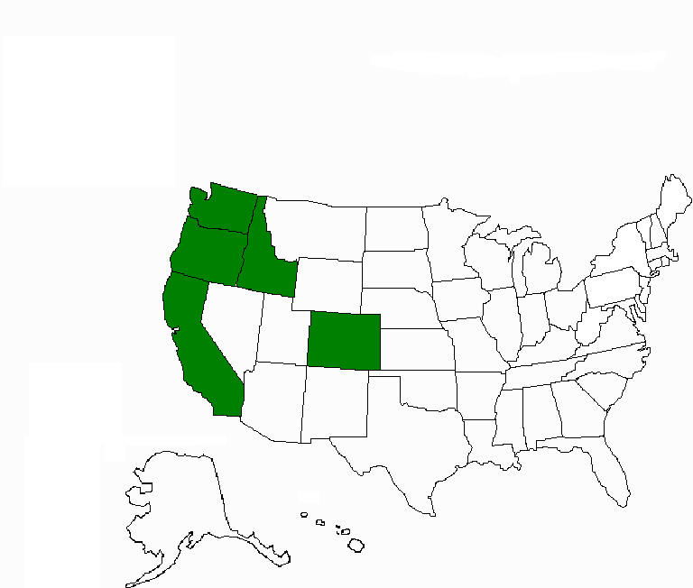
System for Advanced Biofuels Production from Woody Biomass In the Pacific Northwest
PD: R Gustafson, U Washington, $40,000,000 (5 years)
27 Key Personnel from 5 Universities, a Community College Consortium, and 2 Industrial Partners from 5 States:
  Biogasoline, renewable aviation fuel
  Purpose-grown poplar
    GreenWood Resources
  Bioconversion and fuel production
    ZeaChem

Slide 8
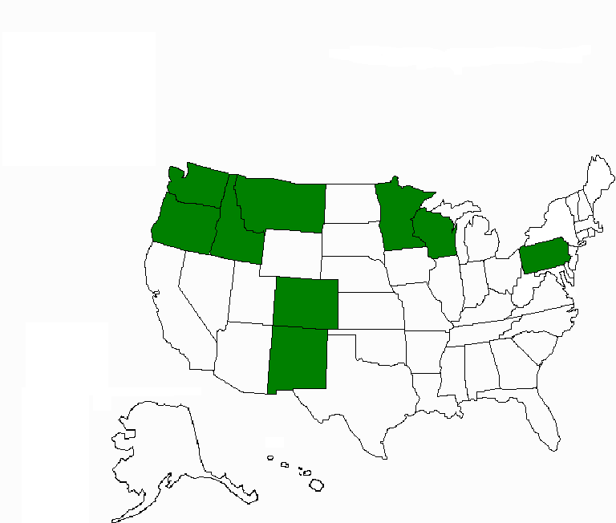
Northwest Advanced Renewables Alliance (NARA): New Vista for Green Fuels, Chemicals, and Products
PD: R Cavalieri, WA St U, $40,000,000 (5 years)
41 Key Personnel representing 9 Universities, 3 Federal Partners, and 6 Industrial Partners from 9 States:
  Renewable aviation fuel, value-added industrial chemicals
  Woody biomass residues
  Weyerhaeuser, other land owners
  Bioconversion and fuel production
    Gevo, Catchlight
  Boeing is on advisory board

Slide 9
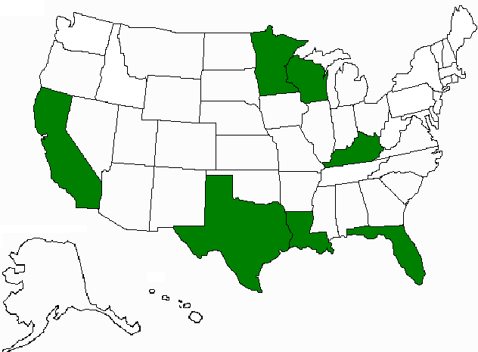
A Regional Program for Production of Multiple Agricultural Feedstocks And Processing to
Biofuels and Biobased Chemicals
PD: D Day, LA St U, $17,300,000 (5 years)
37 Total Key Personnel from 5 Universities, 1 Federal Partner, and 7 Industry Partners in 7 States:
  Biobutanol, gasoline, aviation fuel and industrial chemicals
  Energy cane (ARS, SRU) and sweet sorghum (Ceres)
  Logistics (John Deere)
  Bioconversion to sugars,
  fuel and chemical production
    Virent, DuPont/Genencor, Optinol,
    MS Processes, Intl.

Slide 10
CAAFI 2014
General Meeting
& Expo
Zia Haq,
DOE
Produced by

Slide 11
Alternative Fuels for Aviation
U.S. Department of Energy
Bioenergy Technologies Office
Zia Haq
Program Manager
DPA Coordinator
Bioenergy Technologies Office
January 29, 2014

Slide 12
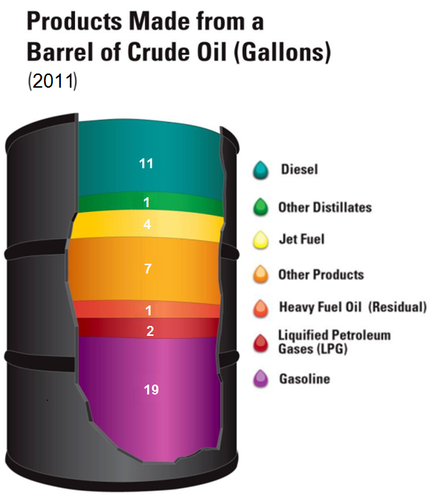
Current Strategic Focus: Replacing the Entire Barrel
In 2011 BETO re-examined its focus:
Cellulosic ethanol only displaces gasoline fraction of a barrel of oil (about 40%).
Reducing dependence on oil requires replacing diesel, jet, heavy distillates, and a range of other chemicals and products.
Greater focus needed on RDD&D for a range of technologies to produce hydrocarbon fuels and displace the entire barrel of petroleum.
Source: Energy Information Administration, “Oil: Crude Oil and Petroleum Products Explained” and AEO2009, Updated July 2012, Reference Case.
*American Petroleum Institute.
Notes:
(Slide taken from Kevin Craig Peer Review 2013 Conversion Plenary)

Slide 13
BETO Thermochemical-based IBR projects – Summary
DOE Funded TC IBR projects
Enerkem | Syngas conversion to methanol-ethanol | Demo/ARRA
INEOS | Syngas fermentation to ethanol | Demo/ARRA
ClearFuels | Syngas to F-T liquids | Pilot/ARRA
Haldor Topsoe | Syngas catalysis to gasoline | Pilot/ARRA
REII | Syngas to F-T Diesel | Pilot/ARRA
UOP | Pyrolysis and hydroconversion to liquid transportation fuels | Pilot/ARRA
GTI | Integrated hydropyrolysis and hydroconversion to gasoline and diesel. | R&D/ARRA
Frontline | Syngas to F-T liquids | iPilot/BETO
Key Accomplishments
INEOS has completed first commercial production of Cellulosic Ethanol, with more than 90% GHG reduction compared to gasoline
1000-hr run for drop-in fuels: Clearfuels
GTI successfully demonstrated fully integrated, IH2 process, beginning scale up activities for pilot/demo
Key Challenges and Barriers
Scale up (and down) issues
Rural power supply reliability
Operations issues
Market issues-NG/GTL
Notes:
Source: CNJV

Slide 14




FY 2013 TC FOA: CHASE
Goal of program effort: To address R&D challenges that were identified at the “Conversion Technologies for Advanced Biofuels” workshop, specifically in Carbon, Hydrogen, and Separations Efficiencies (CHASE) for Bio-oil Pathways.
Three Technical Barrier Areas were identified:
Carbon Efficiency – Typically only the organic phase is processed in subsequent upgrading steps, leaving behind valuable carbon-containing material in the aqueous phase.
Hydrogen Efficiency – Currently, many systems use steam reforming of non-renewable natural gas to generate hydrogen.
Separations Efficiency - The ability to remove destabilizing components from bio-oils is crucial to achieving improved processes for bio-products production.
Selections include the following:
  Ceramatec
  Oak Ridge National Laboratory
  University of Oklahoma
  Virent, Inc.
DE-FOA-0000812
  Federal Funds: up to $12,000,000
  Starting TRL: 2-3
Notes:
(Slide taken from Kevin Craig Peer Review 2013 Conversion Plenary)

Slide 15
Natural Gas/Biomass to Liquids Workshop
The recent development of the increased availability of low cost natural gas has increased opportunities to consider the use of natural gas as a feedstock for conversion into liquid hydrocarbons (GTL).
Co-conversion of natural gas with biomass (GBTL) has the potential of increasing yield of liquid product while also having lower greenhouse gas emissions relative to petroleum.
DOE is interested in further understanding how the use of natural gas and biomass may be optimized and integrated into a conversion process to produce liquid fuels.
  Office of Energy Efficiency and Renewable Energy
  Office of Fossil Energy
  ARPA-E
Notes:
Thank you for coming (esp. after Labor Day!)

Slide 16
GBTL Workshop Results
Rationale for integrating biomass and natural gas resources to produce liquid transportation fuels is: greenhouse gas reduction and the need for a specific C/H ratio in the fuel
GBTL processes can produce transportation fuels with 50% lower GHG emissions if substantial amounts of lignocellulosic biomass is co-processed with natural gas
GBTL processes have significantly higher yields than processes converting only biomass
Stranded biomass and stranded natural gas offer near-term opportunities to utilize currently unutilized feedstocks
Research challenges: down-scaling GTL systems, improved catalysts, biochemical conversion processes, feeding biomass into pressurized systems, production of co-products, and many more.

Slide 17
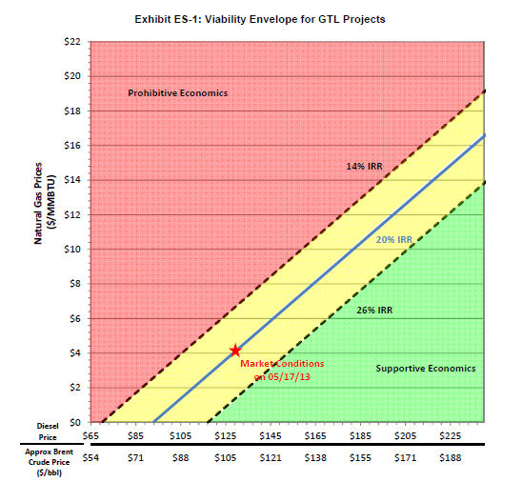
Gas-to-Liquids Cost of Production
Source: NETL, “Analysis of Natural Gas-to Liquid Transportation Fuels via Fischer Tropsch”, DOE/NETL-2013/1597, September, 2013.

Slide 18
REMOTE: Reducing Emissions using Methanotrophic Organisms for Transportation Energy
Ramon Gonzalez, Program Director
Chad Haynes, SETA
Anthony Augustine, T2M Advisor

Slide 19
















REMOTE Portfolio (16* projects, ~$39M)
CAT 1: High-Efficiency Biological Activation of Methane
CAT 1 & 2
Anaerobic
Aerobic
CAT 2: High-Efficiency Biological Synthesis of Fuel
CAT 3: Process Intensification Approaches for Biological Methane Conversion
*Includes 1 OPEN 2012 project and 15 REMOTE projects
Seedling

Slide 20
CAAFI 2014
General Meeting
& Expo
Jim Hileman,
FAA
Produced by

Slide 21
FAA Alternative Jet Fuel Research Update
Event: CAAFI Biennial General Meeting
By: Dr. James I. Hileman
Chief Scientific and Technical Advisor for Environment and Energy
Federal Aviation Administration
Date: January 29, 2014

Slide 22
FAA E&E Research
Utilizing a priority-driven and goals-focused research program to inform solution development to overcome aviation E&E challenges.
FAA Office of Environment and Energy (AEE) R&D:
Advances scientific understanding and analytical capability to characterize and assess aviation’s impact on environment
Supports development of mitigation solutions that reduce environmental impacts of aviation and enhance energy efficiency, sustainability and security
Provides sound scientific data to inform policy making relating to aviation’s energy use and environmental impacts
22
Notes:
Overall Approach:
Use research roadmaps to guide efforts
Further scientific understanding
Develop analytical tools
Mature solutions that could help us meet goals
Conduct analyses to track progress and quantify gaps toward goals
Provide sound scientific data to inform policy making

Slide 23




Current FAA Alternative Jet Fuel Activities
Testing
  Material compatibility
  Certification / Qualification
  Emissions measurements
Analysis
  Environmental sustainability
  Techno-economic analysis
  Future scenarios
Coordination
  Public-Private
  State & Regional
  International
23
Notes:
R&D portfolio is to advance our understanding and play our role as a facilitator of the process
Loosely grouped into four categories:
Performance and emissions Testing of Alternative fuels to support ASTM approval and emission benefits measurement
Analysis on impacts, economics and availability to Improve our understanding and decision making
Coordination and Leveraging efforts across…public-private, iteragency, government and with international partners
Tracking Fuel Use by U.S. aviation to measure progress towards our goals – we work with Airlines for America and the Defense Logistics Agency – Energy to count gallons of fuel used
Our means of conducting the work on the right side

Slide 24
Current FAA Alternative Jet Fuel Activities
Testing
  Material compatibility
  Certification / Qualification
  Emissions measurements
Analysis
  Environmental sustainability
  Techno-economic analysis
  Future scenarios
Coordination
  Public-Private
  State & Regional
  International
24
Notes:
R&D portfolio is to advance our understanding and play our role as a facilitator of the process
Loosely grouped into four categories:
Performance and emissions Testing of Alternative fuels to support ASTM approval and emission benefits measurement
Analysis on impacts, economics and availability to Improve our understanding and decision making
Coordination and Leveraging efforts across…public-private, iteragency, government and with international partners
Tracking Fuel Use by U.S. aviation to measure progress towards our goals – we work with Airlines for America and the Defense Logistics Agency – Energy to count gallons of fuel used
Our means of conducting the work on the right side

Slide 25
Alternative Jet Fuel Pathways & Status
Resource
Waste
Gas
Natural
Gas
Solid
Waste
Lignocellulosic
Biomass
Sugar &
Starch Crops
Terrestrial
Oil Crops
& Waste FOG
Coal
gasification
saccharification
Oil extraction
Process
pyrolysis
Advanced
thermo-
processing
sugars
Bio-
processing
Bio-processing
Intermediate
syngas
alcohols
bio-oil
lipids
F-T
Synthesis
Thermo-
processing
Thermo-
processing
Thermo-
processing
Catalytic Hydrothermolysis
Process
Hydro-
processing
Hydro-
processing
Hydro-
processing
Product
Jet Fuel
Jet
Fuel
FT-
SKA
FT-
SPK
ATJ-SKA
ATJ-SPK
HDCJ
SK, SAK
DSHC
CH
HEFA
ASTM TF
Annex A2 July 2011
ASTM
Status
ASTM TF & Report
Annex A1 Sept 2009
ASTM TF
ASTM TF & Report
ASTM TF & Report
ASTM TF
ASTM TF & Report
Draft – Subject to Revision – Oct 22 2013
Notes:
View of the landscape of possible alternative jet fuels
Broad array of potential options and many different ways to make jet fuel with a Diversity of :
Resources/raw materials/feedstocks
Conversion processes
Chemical intermediates
End Products
2 Fuels are approved for use
7 more under evaluation by ASTM task forces
Great opportunity but each one requires effort

Slide 26
Current FAA Alternative Jet Fuel Activities
Testing
  Material compatibility
  Certification / Qualification
  Emissions measurements
Analysis
  Environmental sustainability
  Techno-economic analysis
  Future scenarios
Coordination
  Public-Private
  State & Regional
  International
Notes:
R&D portfolio is to advance our understanding and play our role as a facilitator of the process
Loosely grouped into four categories:
Performance and emissions Testing of Alternative fuels to support ASTM approval and emission benefits measurement
Analysis on impacts, economics and availability to Improve our understanding and decision making
Coordination and Leveraging efforts across…public-private, iteragency, government and with international partners
Tracking Fuel Use by U.S. aviation to measure progress towards our goals – we work with Airlines for America and the Defense Logistics Agency – Energy to count gallons of fuel used
Our means of conducting the work on the right side

Slide 27
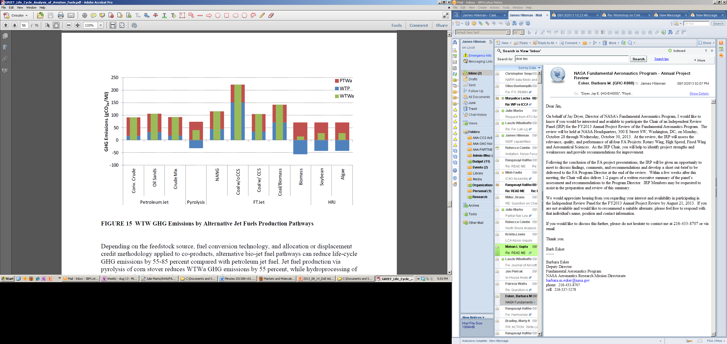
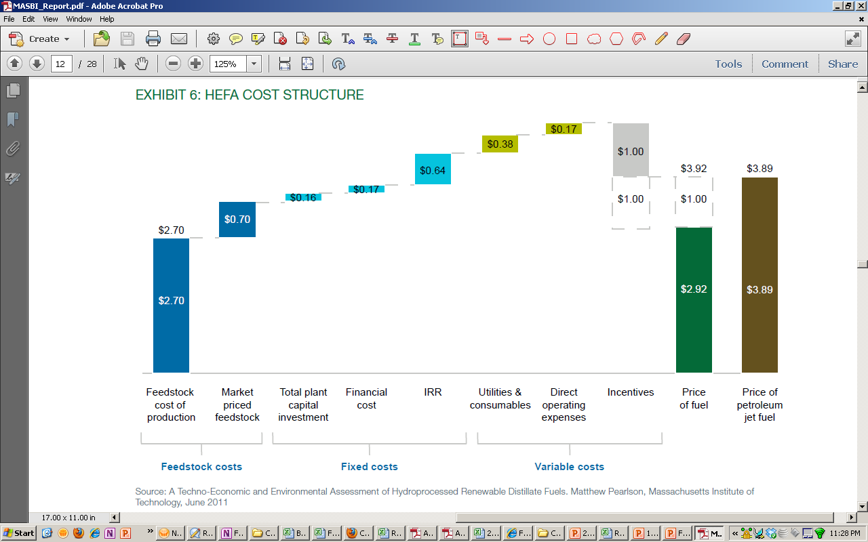
Environmental and Economic Analyses
Environmental analyses
  Focus on well-to-wake GHG, including climate impacts of combustion emissions
  Results incorporated into ANL GREET model and EPA analysis
Economic analyses
  Techno economic analysis that are coordinated with DoE efforts
  Identifying opportunities for cost reduction
Future production scenarios
Research being conducted by PARTNER¹ and ASCENT² COE and Volpe Center
Life Cycle GHG Emissions³
HEFA Cost Structure⁴
http://partner.mit.edu/projects/environmental-cost-benefit-analysis-alternative-jet-fuels
http://ascent.aero
http://greet.es.anl.gov/files/aviation-lca
http://www.masbi.org/content/assets/MASBI_Report.pdf
Notes:
Continuing work at PARTNER has done comaprative analysis of more than a dozen JET fuels
This has been incorporated into the DOE (Argonne NL) GREET LCA model (Greenhouse gas and regulated emissions in Transportation model) --
There are many factors that influence overall GHG footprint, worked to identify the levers.

Slide 28

Current FAA Alternative Jet Fuel Activities
Testing
  Material compatibility
  Certification / Qualification
  Emissions measurements
Analysis
  Environmental sustainability
  Techno-economic analysis
  Future scenarios
Coordination
  Public-Private
  State & Regional
  International
Notes:
R&D portfolio is to advance our understanding and play our role as a facilitator of the process
Loosely grouped into four categories:
Performance and emissions Testing of Alternative fuels to support ASTM approval and emission benefits measurement
Analysis on impacts, economics and availability to Improve our understanding and decision making
Coordination and Leveraging efforts across…public-private, iteragency, government and with international partners
Tracking Fuel Use by U.S. aviation to measure progress towards our goals – we work with Airlines for America and the Defense Logistics Agency – Energy to count gallons of fuel used
Our means of conducting the work on the right side

Slide 29


New FAA Programs
Aviation Sustainability Center (ASCENT)
New Center of Excellence for Alternative Jet Fuel and Environment
Continuous Lower Energy, Emissions and Noise (CLEEN) II
Reduce aircraft fuel burn, emissions and noise through technology & advance alternative jet fuels
Sustainability and Environmental Management Research Support (SEMRS)
Supporting FAA with Sustainability, Environmental Management, Research, and Additional Support activities
Open solicitation that closes Feb 11: https://faaco.faa.gov/index.cfm/announcement/view/15569
Notes:
COE Technical Areas – Alt Jet Fuels
Feedstock Development, Processing and Conversion Research
Regional Supply and Refining Infrastructure
Environmental Benefits Analysis
Aircraft Component Deterioration and Wear Assessment
Fuel Performance Testing
COE Technical Areas – Environment
Aircraft Noise and Impacts
Aviation Emissions and Impacts
Aviation Modeling and Analysis
Aircraft Technology Assessment
Environmentally and Energy Efficient Gate-to-Gate Aircraft Operations

Slide 30
ASCENT Overview
Overview of Award
Partnership among universities, commercial firms, and government laboratories to conduct research and education
Expands environment and energy research carried out by PARTNER to address alternative jet fuel research request in 2012 FAA Modernization and Reform Act
COE brings together expertise of PARTNER COE with USDA AFRI Regional Bioenergy Coordinated Agriculture Projects (CAPS) and SunGrant Initiative
Award announcement: September 13, 2013
Duration: five years; renewable once (ten year total)
Funding: at least $4 million annually from FAA plus 100% cost share requirement
Sponsor engagement: U.S. government agencies (FAA, USDA, DoE, DoD, EPA, NASA) and Transport Canada
ASCENT Website: http://ascent.aero
Notes:
USDA AFRI CAP
USDA National Institute of Food and Agriculture (NIFA) Agriculture and Food Research Initiative (AFRI) Sustainable Bioenergy Challenge Coordinated Agricultural Projects (CAP)
Program funded with $156M over five years to enhance rural prosperity and national energy security through the development of regional systems for the sustainable production of advanced biofuels and biobased products
WSU, UW, PSU, and U Tenn lead AFRI CAP (others are ISU, LSU and CSU)
USDA Sun Grant Initiative
- Working with the U.S. Department of Agriculture, the Sun Grant Regional Centers are seeking to bring an industrial ecology framework to the development of agricultural-based biofuels and bioproducts systems by developing a database that captures the non-linear behavior of capacity in three core subsystems of biomass utilization: feedstock production, feedstock logistics and feedstock conversion. The Sun Grant Initiative is developing an interactive input/output modeling method for structuring and analyzing agriculturalbased biofuels and bioproducts systems.

Slide 31
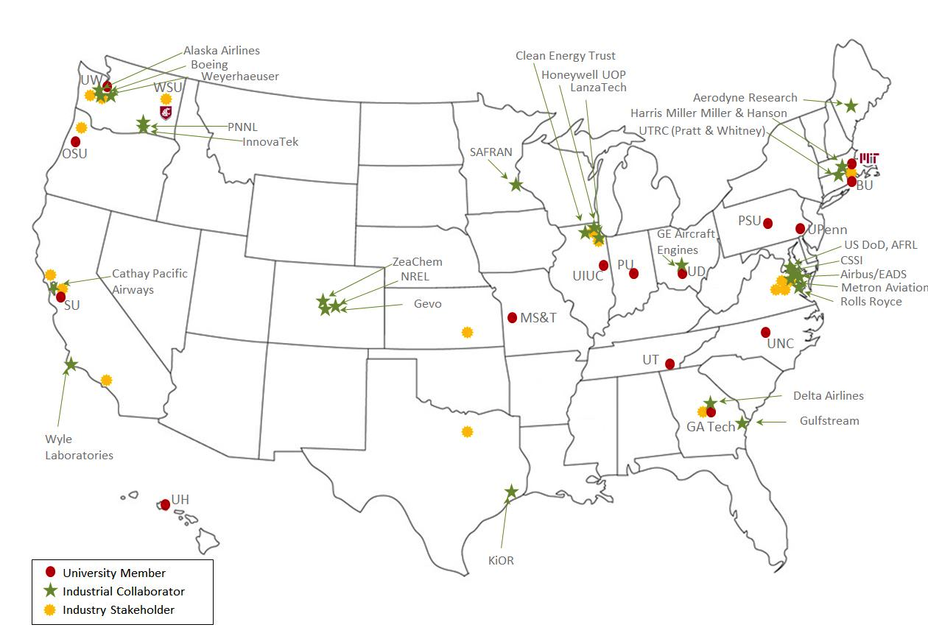

Lead Universities:
Washington State University (WSU)*
Massachusetts Institute of Technology (MIT)
Core Universities:
Boston University (BU)
Georgia Institute of Technology (Ga Tech)
Missouri University of Science and
Technology (MS&T)
Oregon State University (OSU)*
Pennsylvania State University (PSU)*
Purdue University (PU)*
Stanford University (SU)
University of Dayton (UD)
University of Hawaii (UH)
University of Illinois at Urbana-Champaign (UIUC)*
University of North Carolina at Chapel Hill (UNC)
University of Pennsylvania (UPenn)
University of Tennessee (UT)*
University of Washington (UW)*
* Denotes USDA NIFA AFRI-CAP Leads and Participants
ASCENT Website: http://ascent.aero

Slide 32
Continuous Lower Energy, Emissions and Noise (CLEEN) Phase II
FAA R&D Program:
  Reduce aircraft fuel burn, emissions and noise through
  technology & advance alternative jet fuels
  1:1 minimum cost share requirement
CLEEN I: 2010-2015 ($125M FAA Funding)
  Alternative Jet Fuel Projects with Boeing, Rolls Royce, Pratt & Whitney, and Honeywell
CLEEN II: 2015-2020 ($100M FAA Funding)
  Industry Day - December 3, 2013 in Washington DC
  Solicitation expected in mid-2014
  More information available at: http://www.faa.gov/about/office_org/headquarters_offices/apl/research/aircraft_technology/cleen/
32

Slide 33
Summary
Alternative jet fuels are a key component of FAA strategy in meeting environmental goals
FAA efforts are directed to overcoming key challenges via testing, analysis and coordination
Multiple programs and activities:
  Commercial Aviation Alternative Fuels Initiative (CAAFI)
  Continuous Lower Energy, Emissions and Noise
  (CLEEN) Program
  Aviation Sustainability Center (ASCENT)
  National Alternative Jet Fuel Strategy development
33

Slide 34
Backup – will not be in deck that goes out publicly

Slide 35

ASCENT Structure

Slide 36
University Partners & Advisory Committee
University Partners
Boston University
University of Dayton
Georgia Institute of Technology
University of Hawaii
Massachusetts Institute of Technology
University of Illinois at Urbana-Champaign
Missouri University of Science and Technology
University of North Carolina at Chapel Hill
Oregon State University
University of Pennsylvania
Pennsylvania State University
University of Tennessee, Knoxville
Purdue University
University of Washington
Stanford University
Washington State University
Advisory Committee
Aerodyne Research
Airbus
Airlines for America
Airports Council International – North America
Alaska Airlines
Amyris/Total
Argonne National Laboratory
Boeing
Cathay Pacific Airways
Ceres
Cessna Aircraft
City of College Park, GA
Clean Energy Trust
Climate Solutions
CSSI
Delta Air Lines
Embraer
General Electric Aviation Systems
Gevo
Gulfstream
Harris Miller Miller & Hanson
Honeywell (Aerospace and UOP)
Imperium Renewables
InnovaTek
International Airline Passengers Association
KiOR
LanzaTech
LMI
Massachusetts Port Authority
Metron Aviation
National Organization to Insure a Sound-Controlled Environment (NOISE)
National Renewable Energy Laboratory
Palisades Citizens Association
Pacific Northwest National Laboratory
Port of Portland
Port of Seattle
Rolls Royce
SAFRAN
San Francisco International Airport
Spokane International Airport
Sustainable Aviation, UK
United Airlines
United States Air Force Research Laboratory
United Technologies Research Center (United Technologies Corporation)
Weyerhaeuser NR
Wyle
ZeaChem

Slide 37
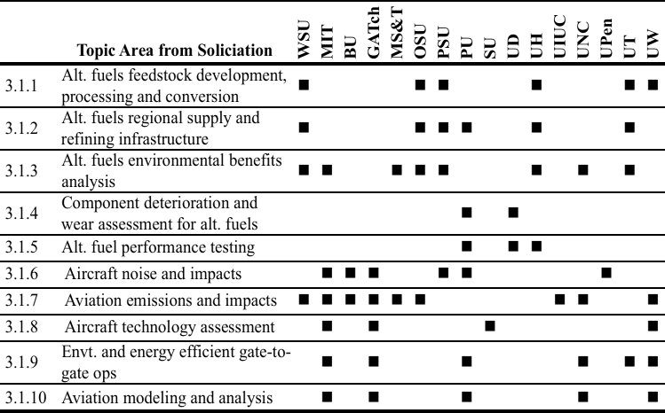
ASCENT University Expertise
37

Slide 38
CAAFI 2014
General Meeting
& Expo
Dan Friend,
DOC
Produced by

Slide 39

Department of Commerce and Alternative Aviation Fuels
Daniel G. Friend
Special Assistant to the Director (Energy Research)
National Institute of Standards and Technology
Office of Special Programs
Boulder, CO
Panel on Public-Private Partnership Efforts
CAAFI General Meeting
Washington, DC
29 January 2014
Daniel.friend@nist.gov
Notes:
Please edit red text when developing your

Slide 40
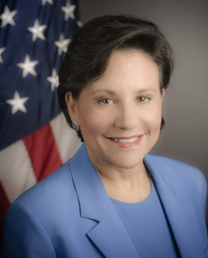
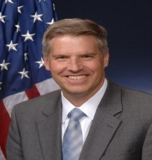
DOC “… promotes job creation, economic growth, sustainable development and improved standards of living for all Americans by working in partnership with businesses, universities, communities and our nation’s workers. … a wide range of responsibilities in the areas of trade, economic development, technology, entrepreneurship and business development, environmental stewardship, and statistical research and analysis.”
Bureau of Economic Analysis (BEA) Bureau of Industry and Security (BIS)
U.S. Census Bureau Economic Development Administration (EDA)
Economics and Statistics Administration (ESA)
International Trade Administration (ITA)
Minority Business Development Agency (MBDA)
National Oceanic and Atmospheric Administration (NOAA)
National Telecommunications and Information Administration (NTIA)
National Institute of Standards and Technology (NIST)
National Technical Information Service (NTIS)
U.S. Patent and Trademark Office (USPTO

Slide 41
Promoting foreign direct investment and export opportunities for U.S. companies; technologies and atmospheric measurements in support of decision making related to global climate change; Advancing measurements and standards; resolving issues preventing innovation and trade. | Organizing events to assist foreign investment in the U.S.; assisting in selling and licensing of relevant products and technologies to overseas clients; promoting harmonization of international standards and practices. Developing atmospheric chemistry, transport, and climate models; developing atmospheric measurement techniques and instruments; conducting atmospheric measurements from a variety of platforms; evaluating the role of aircraft emission sources in the troposphere and stratosphere; evaluating the potential impacts on ecosystems. Developing measurement methods and performing measurements; providing calibrations; developing reference materials and reference data; supporting development of standards. | To facilitate successful commercial deployment and trade in fuels. To assess the role of emissions from the use of alternative jet fuels in the climate system and ecosystems. To eliminate measurement and standards barriers that inhibit innovation and trade in alternative jet fuels.
Minimize the barriers--associated with technical uncertainties, incompatibility of standards, and trade impediments--for adoption of drop-in alternative jet fuels.
Activities:
Lead efforts to resolve barriers to international trade
Evaluate and assess climate change and ecosystem implications
Conduct measurements and develop measurement methods
Work with standards developing organizations
Support economic development & tech needs of small/mid-size manufacturing enterprises
Protect intellectual property
Notes:
Provide your Agency and (if applicable) sub agency interest, role and goal, and any metrics your agecy is using.
Please work off of already developed information in separately attached overview slides.

Slide 42
International Trade Administration
Partnering with CAAFI
Global network of industry & international business experts—help U.S. companies compete
SelectUSA program to promote opportunities and investment (http://selectusa.commerce.gov)
150 industry experts in DC; offices in 70 countries, 100 U.S. cities—trade data and analysis
Hosted first CAAFI Business Team Mtg in 2008
Worked with CAAFI and Kallman to promote business opportunities and foreign direct investment—airshows
Works with CAAFI to connect alt fuels companies with DOC resources (local, global)
Alexis Haakensen alexis.haakensen@trade.gov
Cora Dickson cora.dickson@trade.gov

Slide 43


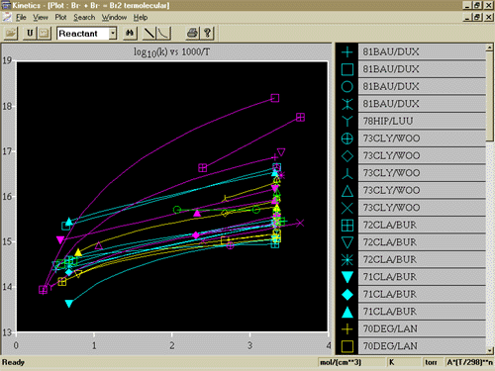
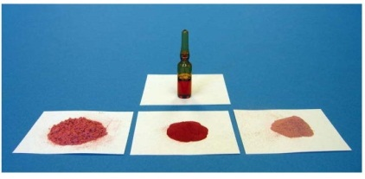
NIST Metrology, Standards, and Technology
Fundamental Research
Measurement Services
Standards Support
  U.S. Inquiry Point WTO TBT
  www.nist.gov/sco
Standard Reference Materials
  Physical artifacts with certified physical and/or chemical properties
Standard Reference Data
  Evaluated numeric data on physical or chemical properties
  Scientific algorithms on behavior of systems
Calibrations

Slide 44
NIST Partnership Opportunities
User Facilities
  Center for Nanoscale Science and Technology (CNST)
  NIST Center for Neutron Research (NCNR)
Manufacturing Extension Partnership (MEP)
  1200 technical experts; centers in every state
  Make it in America; E3—Economy, Energy, Environment
  www.nist.gov/mep
Laboratory Programs
  Collaborations, CRADAs, …
Contacts: Dan Friend (Office of Special Programs) daniel.friend@nist.gov
        Nick Barbosa (Material Measurement Laboratory) nicholas.barbosa@nist.gov
NIST

Slide 45
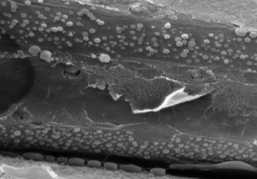
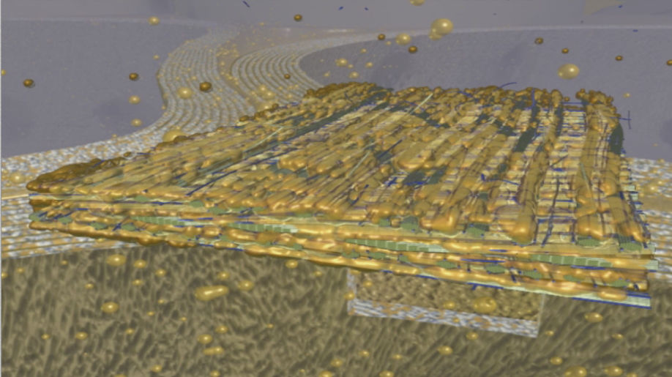
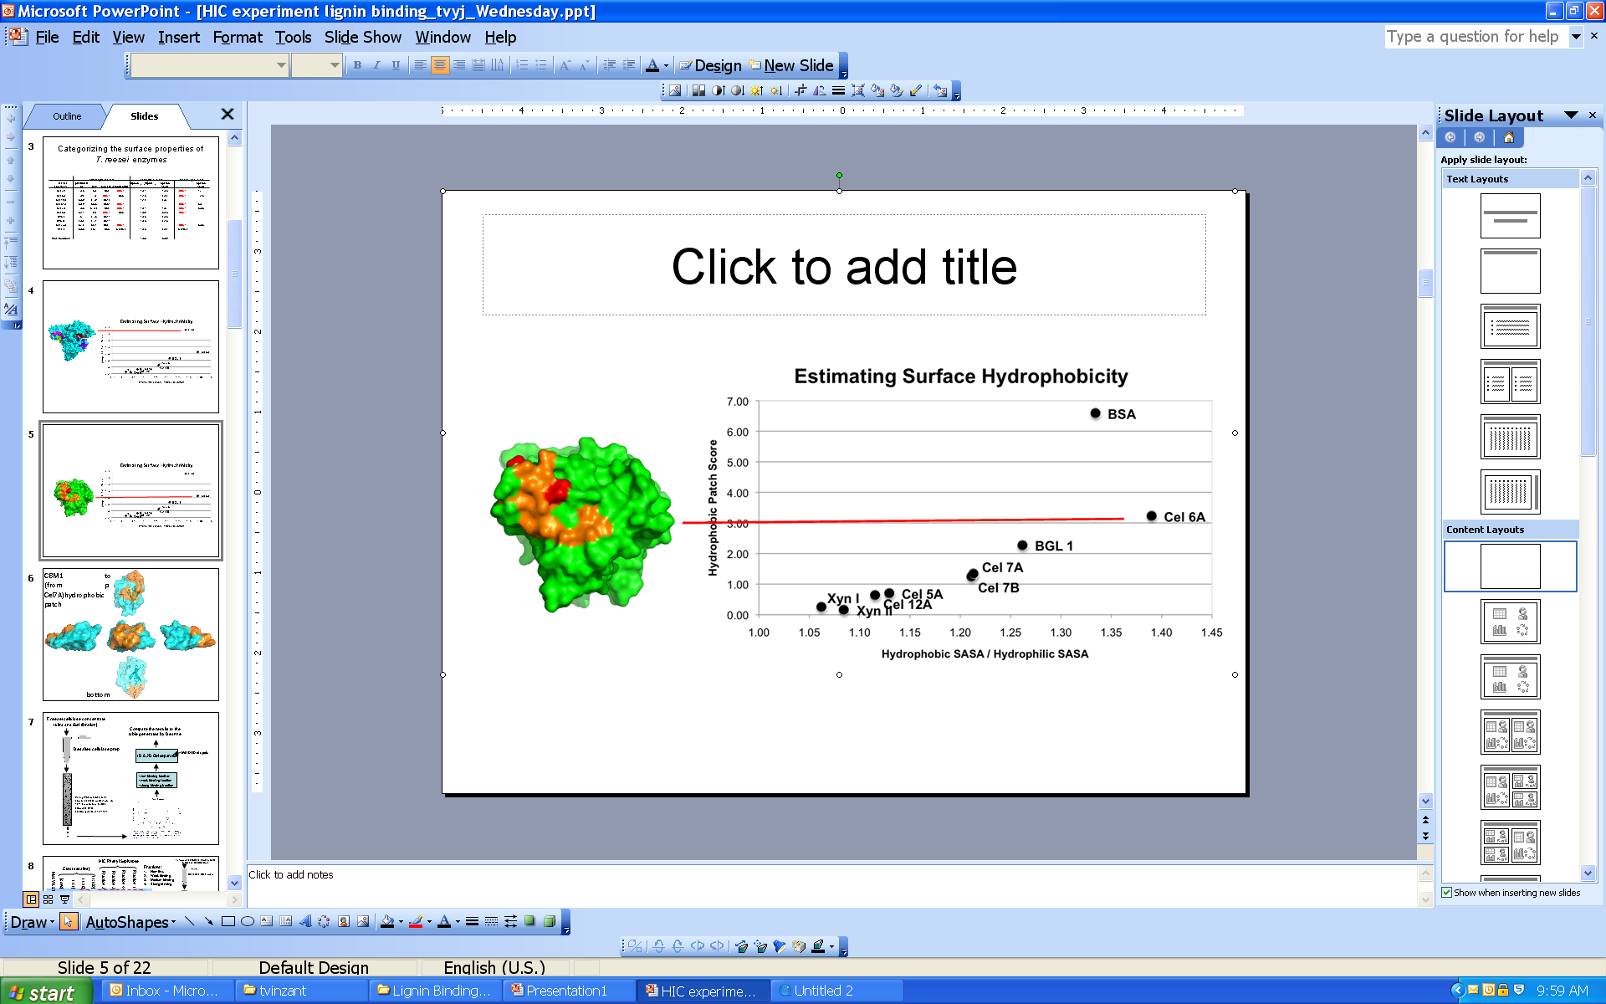
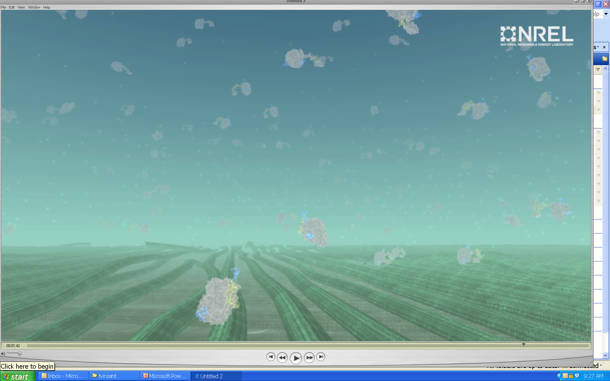
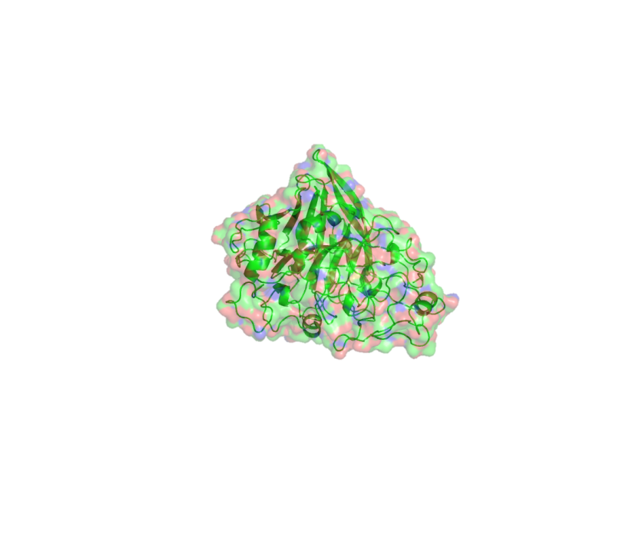
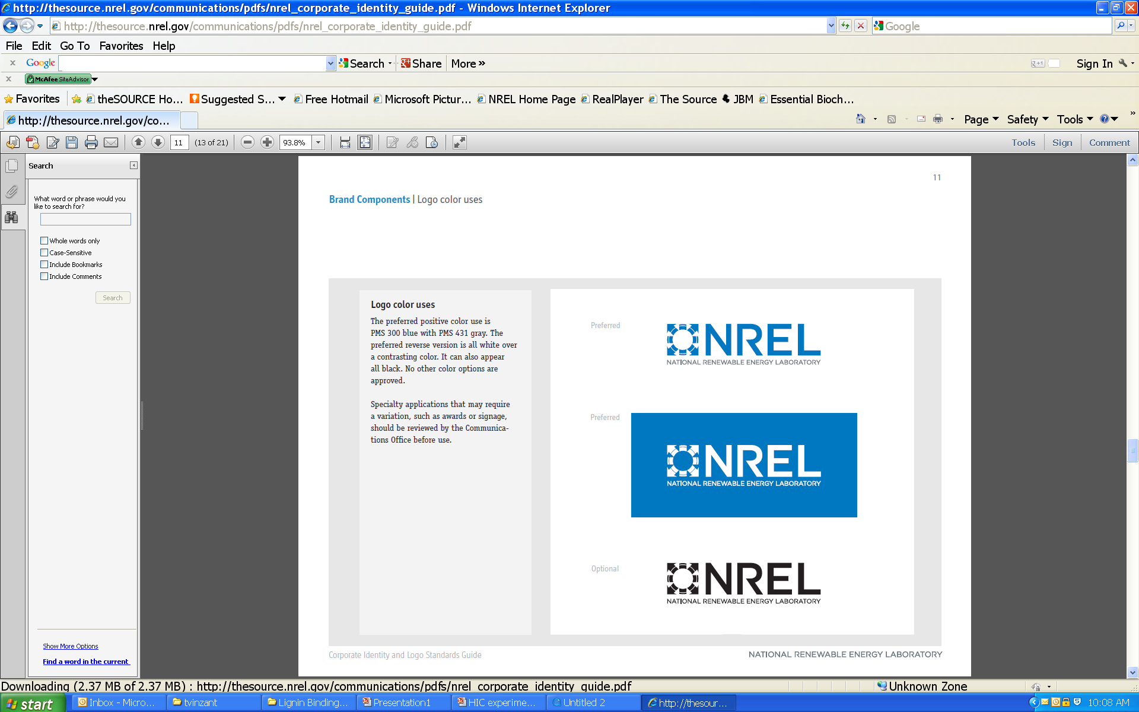
Next Generation Biofuels:
Enzyme/thermochemical processing
Coalesced lignin
Interaction of T. Reesei cellulases with lignin from thermochemical treatment using quartz-crystal micro-balance
Background: Fungal secretome has many glycoside hydrolases that depolymerize cellulose and hemi-cellulose.
Enzymes work synergistically
Productivity is lost in the presence of lignin
Objective: Investigate interaction of enzymes in presence of lignin using QCMD
Elucidate the mechanism(s) of non-productive binding of enzymes to lignin
  specific/non-specific binding
  protein denaturation
  steric interference
Identify which enzymes are affected and develop strategies to overcome this process impact
SEM image
Thermochemical treatment of biomass
Enzyme properties affect binding
T. reesei Cel7A cellulose interaction

Slide 46
CAAFI 2014
General Meeting
& Expo
Mohan Gupta,
FAA
Produced by

Slide 47
Development of National Alternative Jet Fuels R&D Strategy
Research, Development, Demonstration, and Deployment (RD3)
Challenges, Opportunities, and Strategic Way Forward
Mohan Gupta, FAA
Co-Chair of the Federal Interagency Coordination Group
Tri-Chair of the NSTC/ASTS Energy & Environment Working Group
January 29, 2014

Slide 48
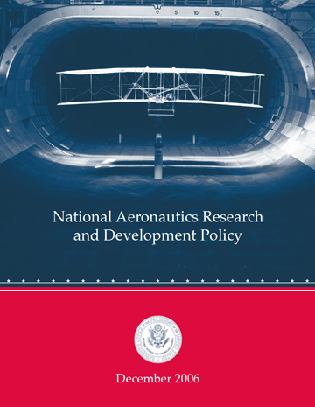

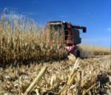

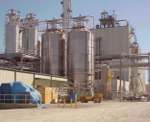
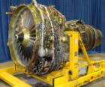

Background: National Aeronautics Research & Development Plan
Developed under sponsorship of the National Science & Technology Council, Aeronautics S&T Subcommittee (ASTS)
Plan focuses on 17 aeronautics goals in four areas –
Mobility, Security, Safety and Environment and Energy
Energy Availability, Efficiency & Environmental Protection
  Goal 1: “Enable new aviation fuels derived from diverse & domestic resources to improve fuel supply security & price stability”
Feedstock
Production
Feedstock
Logistics
Fuel
Conversion
Conversion & Scale-up
Fuel Testing/Approval
Enable Production
End User/ Buyer
Fuel Performance
Environment Assessment
USDA |  |  |  |  | ---
DOC | ✓ | --- | ✓ | ✓ |  |  | ---
DOD | --- | --- | --- | ---
DOE |  |  |  |  | --- |  |  | ---
EPA | --- | --- | --- | --- | --- |  |  | ---
FAA | --- |  | --- |  |  |  | ---
NASA | --- | --- | --- | --- |  |  | --- | ---
NSF |  |  |  | --- | --- | --- | --- | ---

Slide 49
Development of National Alternative Jet Fuels R&D Strategy
Overarching R&D Challenges
  Development of types and geographical diversity of feedstocks
  Production and yield efficiency of feedstock
  Sustainable and dependable supply
  Conversion efficiency and commercial scale production
  Jet specificity and demand for byproducts
  Cost-competitiveness
  ASTM approval for performance, safety and operability
  Environmental sustainability and resource demand
Currently - no common guiding path that defines an actionable R&D strategy to help meet these challenges.

Slide 50
Development of National Alternative Jet Fuels R&D Strategy
Intended Purpose
Identify opportunities and strategically address challenges associated with Research Development Demonstration and Deployment (RD3) along the supply-chain of alternative jet fuels.
National AJF R&D Strategy – A mechanism to
  Articulate Achievable Objectives, Measurable Performance Metrics and Timeline to achieve the goal
  Mobilize the federal and non-federal stakeholders community towards achieving the common goal and objectives
  Understand industry needs and target federal strategic R&D efforts to address RD3 challenges along the alternative jet fuels supply-chain
  Integrate, align and coordinate interagency activities
  Promote increased collaboration
  Enhance technology transfer
DRAFT Goal Statement
Enable the development, production, and use of environmentally sustainable, cost-competitive and socially responsible alternative jet fuel with stable supply to significantly meet the needs of U.S. jet aviation

Slide 51
Development of National Alternative Jet Fuels R&D Strategy
  Stakeholders’ input is integral to inform the development of this Strategy
  STPI surveyed stakeholders to identify R&D challenges along the supply-chain
  STPI organized stakeholders workshop on Jan 7, 2014 to discuss these challenges
  Interagency Coordination Group (ICG) continues to draft the Strategy
  ICG recognizes the value in follow-up efforts after the release of the Strategy
  Implement a process for a periodic assessment of the federal and community-wide progress made towards meeting the Strategy goal and identify R&D adaptations to meet evolving challenges, as needed.

